Slide 1
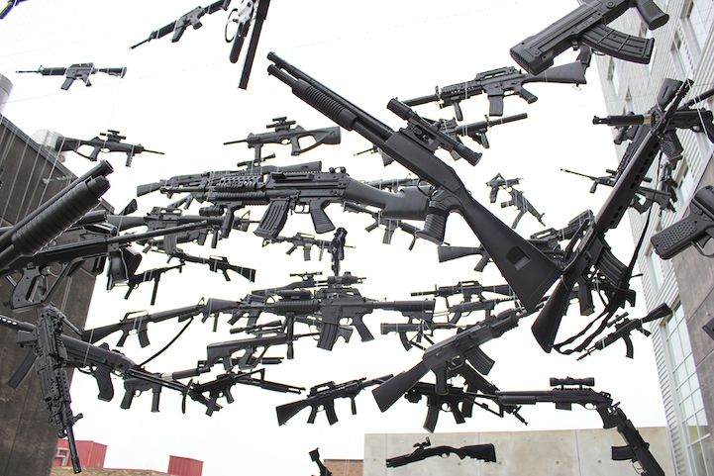
Cloudy with a Chance of Crime
Rula Othman
Jia Fan
Lucas Liang
Notes:
Rula

Slide 2
Project Description
Whether it’s gloomy day glooms or that heat wave grumpiness, it seems temperature does have an effect on crime rate. Cold seems to bring it down, while warmer temperatures opposite. However, delving deeper we would like to analyze if the temperature changes are so extreme that they can lead to elevated crime incidents in the city of Chicago. Why Chicago you may ask? It is a city with a wide array of temperature fluctuations and considered as one of the most dangerous cities in the U.S.
Notes:
Rula

Slide 3
Outline
Hypothesis
Questions of Exploration
Data Sets
Data Cleanup
Data Exploration & Visualization
Analysis & Summary
Conclusion
What happens now?
Notes:
Rula

Slide 4
Hypothesis
Is there significant correlation between temperature and crime incident. For example, high temperature may cause high frequency of crime or vice versa.
Notes:
Rula

Slide 5
Questions of Exploration
Do crime and temperature data have similar trends?
If so what season exhibits largest number of crimes?
What types of crimes showed the most incidents?
Is there a correlation between regional temperature changes and number of crime incidents reported in Chicago?
Notes:
What motivated us?
Rula

Slide 6
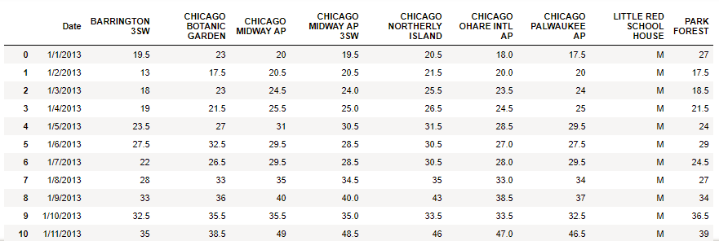
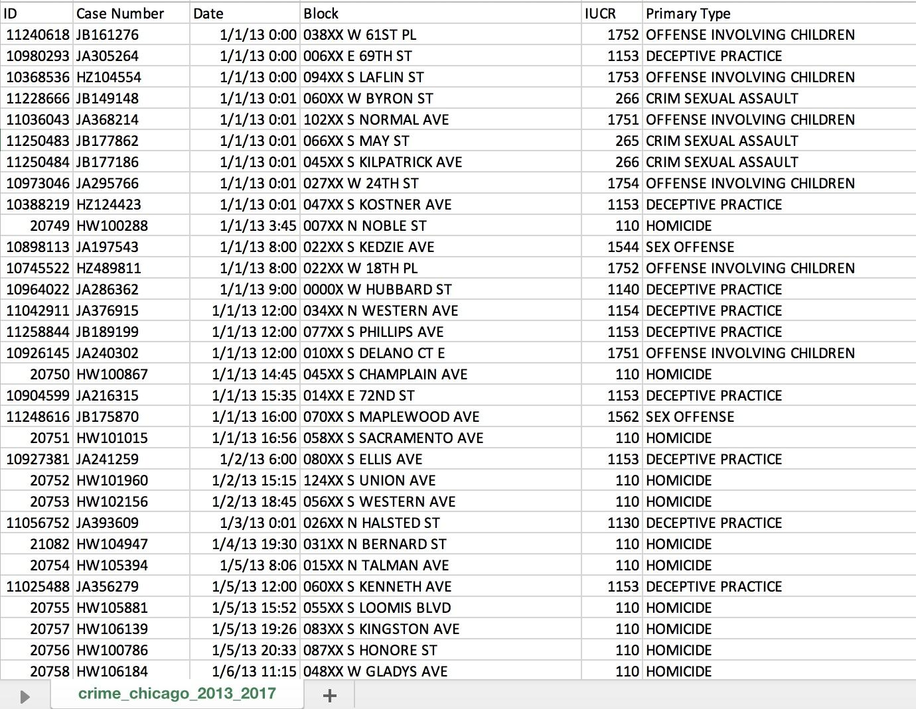
Data Sets
Chicago’s Temperature (F):
Chicago’s Crimes:
Population:
5 years of historical data, from 2013 to 2017
1.3 million crime incidents records
5 years of daily temperature records
Source:
City of Chicago, Data Portal
Midwest Regional Climate Center
Notes:
Lucas
Two datasets were used for the purpose of our analysis.
The dataset containing chicago temperature information from 2013-2017 was obtained using midwest climate center
The data set containing crime information from 2013-2017 was obtained using…?

Slide 7
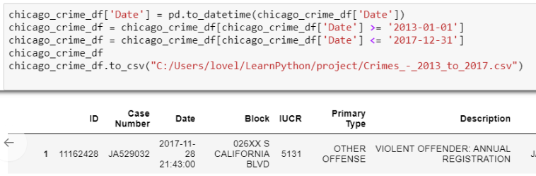
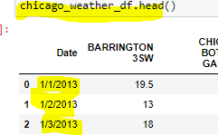
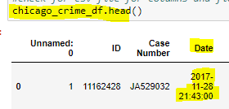
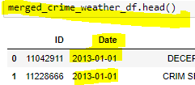
Data Cleanup:
Filter sample data population for Crime due to large data (1.5GB, approx. 3 million records from year 2001 to present):
Identify and format primary key for dataframe merge:
Standardize “Date” field on both data set (temperature and crime)
Notes:
Lucas

Slide 8
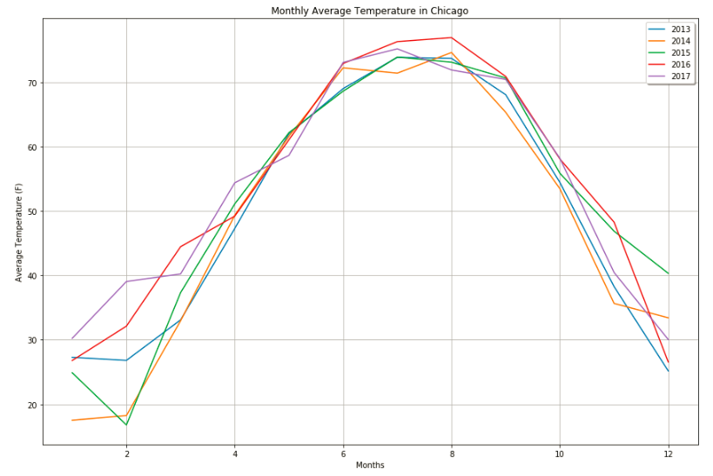
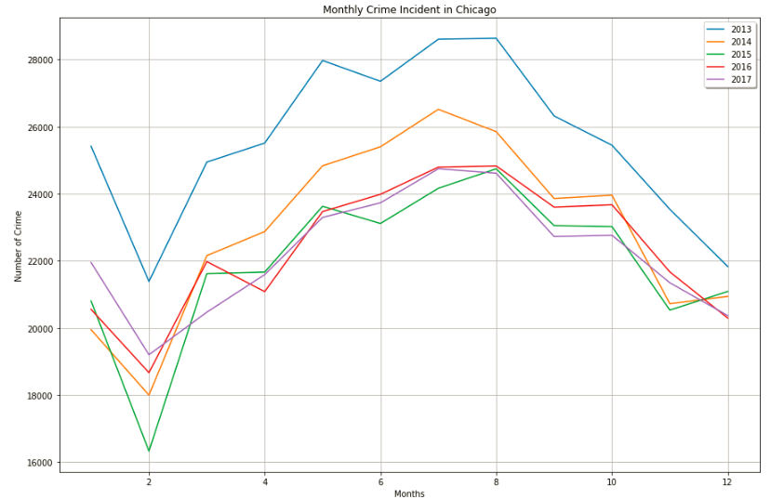
Data Exploration, Correlation Testing
Notes:
Jia
Do crime and temperature data have similar trends?
Plot each csv into its own line graph to observe the trends (2 out of the 8 images)

Slide 9
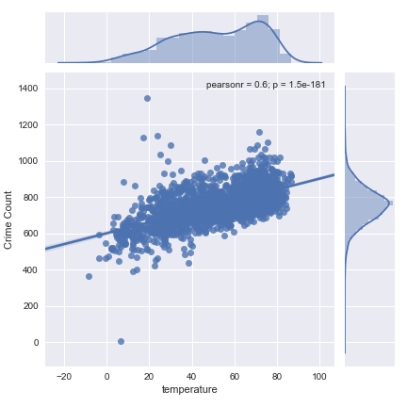
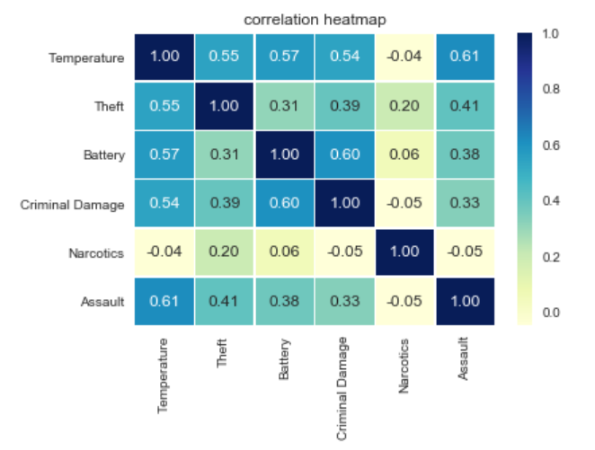
Data Exploration, Correlation Testing
P-value is 1.5e-181 suggesting a very strong correlation.
Notes:
Jia
Do crime and temperature data have similar trends?

Slide 10
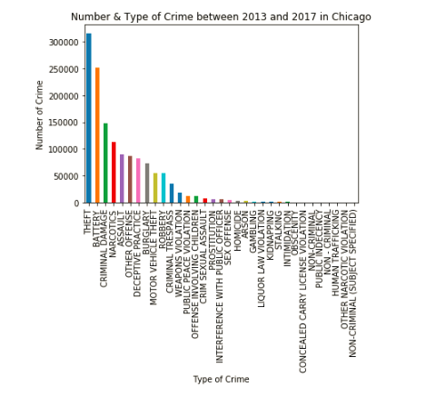
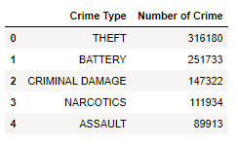
Data Exploration, Top Five Types of Crime
Notes:
Jia

Slide 11
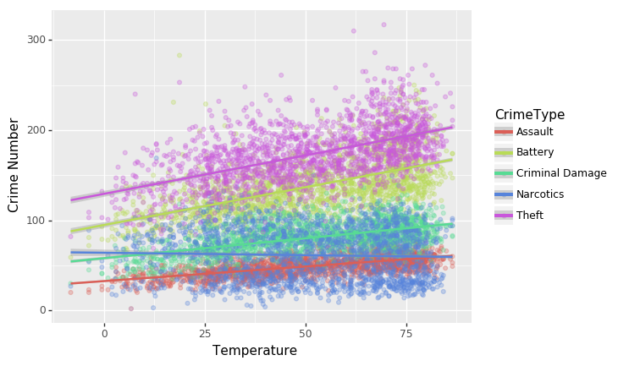
Data Exploration, Top Five Crime vs. Temperature
Notes:
Jia
What types of crimes showed the most incidents?
Another table showing top 5 crime types with number of crimes (1 out of 8 images)

Slide 12
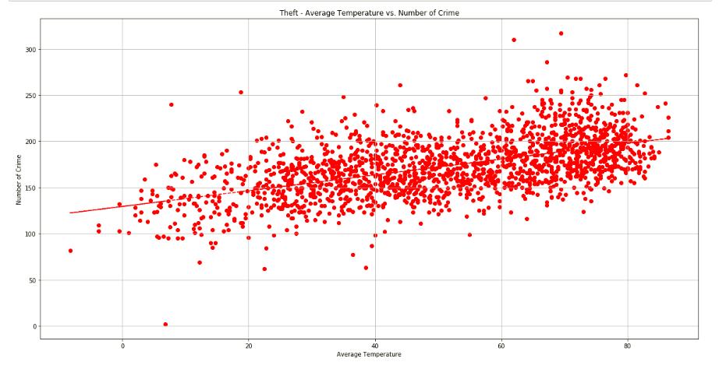
Data Exploration, Theft vs. Average Temperature
Notes:
Lucas
Is there a correlation between regional temperature changes and the crime frequency observed in Chicago?
Scatter Plot of the crimes using matplotlib with a corresponding line of best fit (4+ out of 8 images)

Slide 13
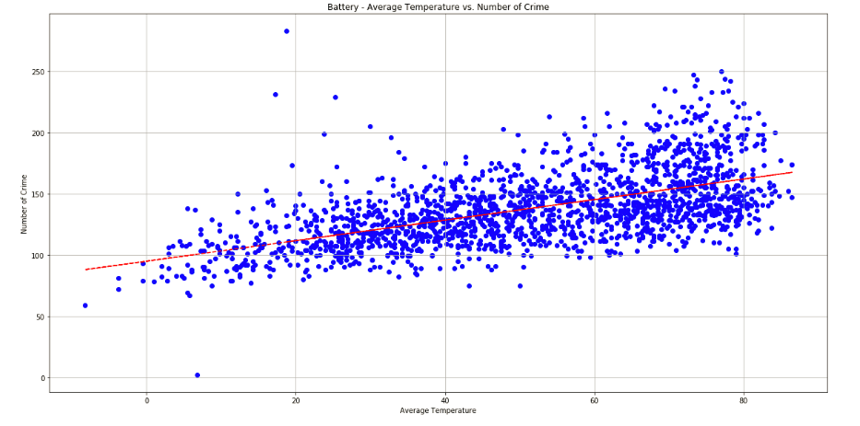
Data Exploration, Battery vs. Average Temperature
Notes:
Lucas
Is there a correlation between regional temperature changes and the crime frequency observed in Chicago?
Scatter Plot of the crimes using matplotlib with a corresponding line of best fit (4+ out of 8 images)

Slide 14
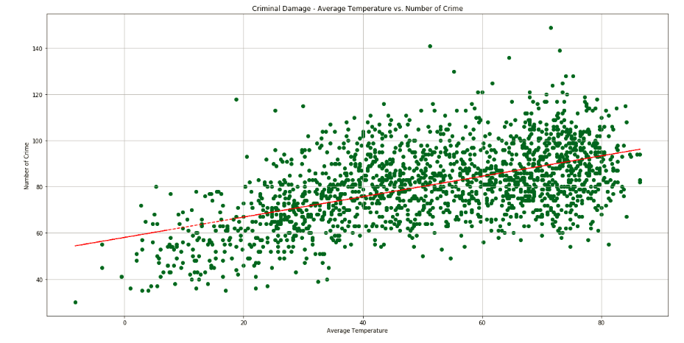
Data Exploration, Criminal Damage vs. Average Temperature
Notes:
Lucas
Is there a correlation between regional temperature changes and the crime frequency observed in Chicago?
Scatter Plot of the crimes using matplotlib with a corresponding line of best fit (4+ out of 8 images)

Slide 15
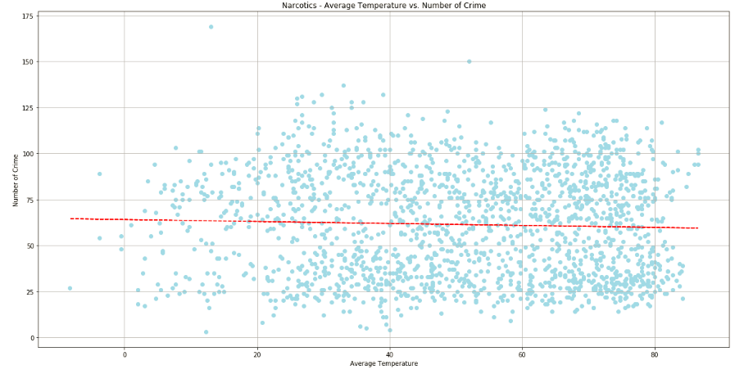
Data Exploration, Narcotics vs. Average Temperature
Notes:
Lucas
Is there a correlation between regional temperature changes and the crime frequency observed in Chicago?
Scatter Plot of the crimes using matplotlib with a corresponding line of best fit (4+ out of 8 images)

Slide 16
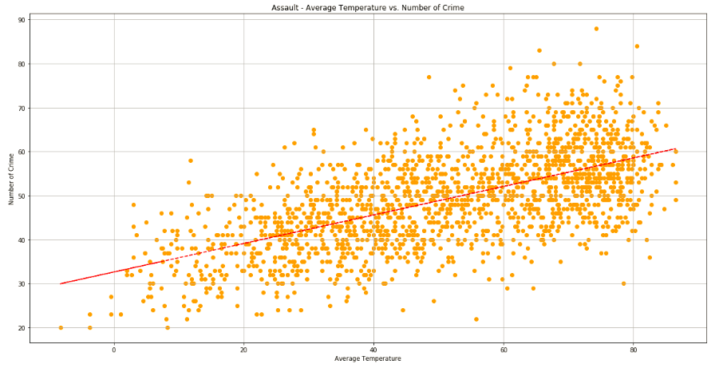
Data Exploration, Assault vs. Average Temperature
Notes:
Lucas
Is there a correlation between regional temperature changes and the crime frequency observed in Chicago?
Scatter Plot of the crimes using matplotlib with a corresponding line of best fit (4+ out of 8 images)

Slide 17
Analysis & Summary
There is a strong correlation between greater number of reported crime incidents and higher temperatures observed through our data analysis dependent on crime type.
Highest crime incidents were observed throughout the summer months from July to September leading us to believe that heat may be an influencer in aggression causing the higher number of crime incident.
Mental health was hypothesized to be a possible correlating factor in influencing crime incidents however due to HIPAA laws, we were unable to find datasets in order to prove or disprove this theory.
Notes:
Rula

Slide 18
Analysis & Summary (continued)
External factors like socioeconomic status, population changes, and geopolitics may be contributing factors, however this was not tested in our analysis.
Some crime types show a stronger correlation with temperature than others. We may assume alternate variables are influencing the crime types that do not have significant correlation with temperature such as Narcotics indicidents.
Notes:
Rula

Slide 19
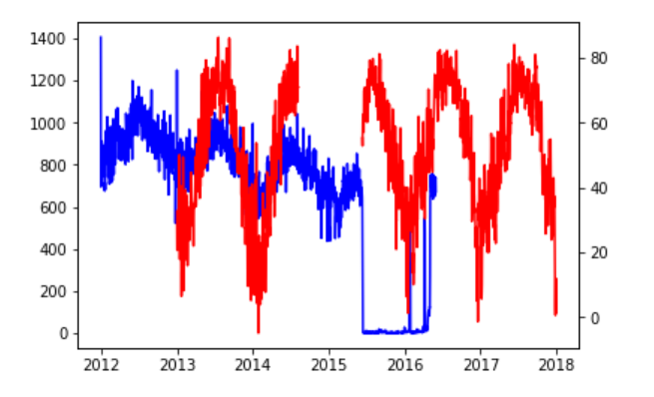
Reflections, Missing Data
10 months of temperature data were missing from OpenWeatherMap dataset
Original Crime data set was incorrect / corrupted due to download error
Notes:
Rula

Slide 20
Conclusion
In conclusion, we proved our hypothesis to be true:
If the temperature fluctuates, then we will likely observe a shift in number of crime incidents.
Notes:
Rula

Slide 21
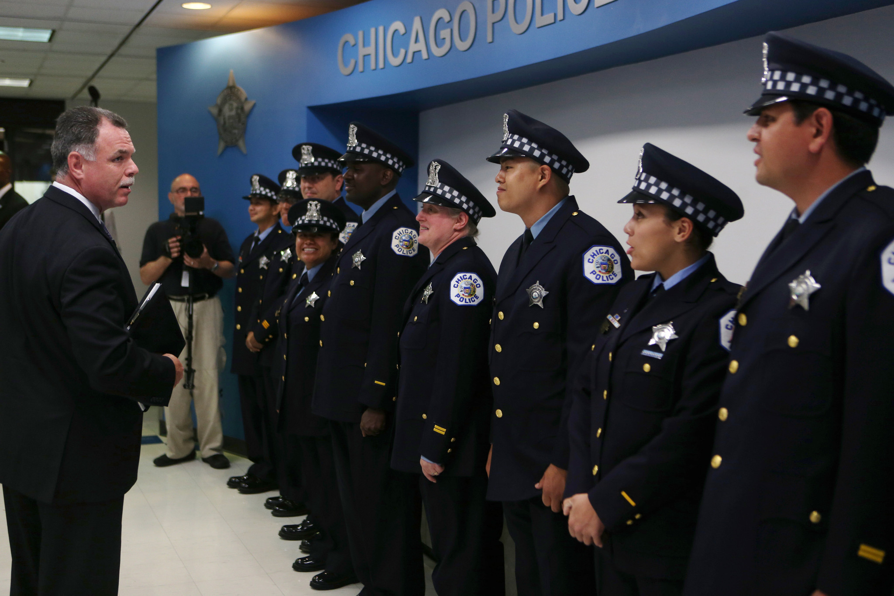
What happens now?
Notes:
Rula
Police better staffing
Can better forecast crime to more efficiently be prepared and properly staff for it

Slide 22
Questions or comments?

